Slide 1
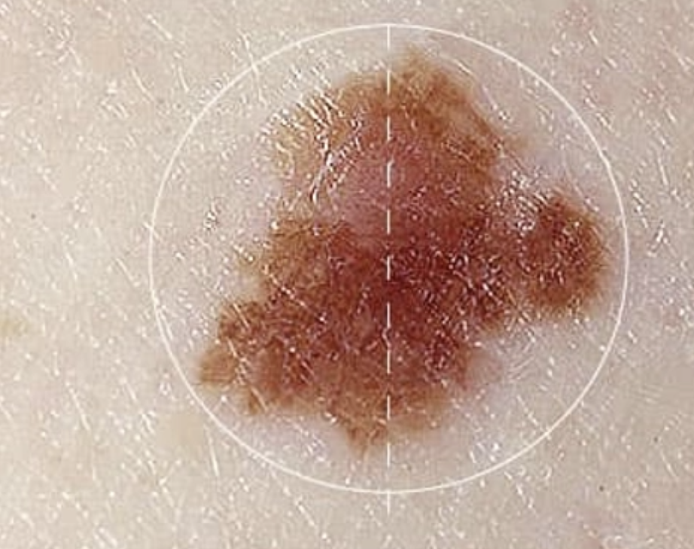
Healthcare Predictive Analysis in Oncology: Skin Cancer
Made By -
Chitra Dusane

Slide 2







Summary
Introduction
Objective
Dataset
Visualization
Models
Results
References

Slide 3
Introduction
It is estimated that approximately 9,500 people in the U.S. are diagnosed with skin cancer every day.
More than 1 million Americans are living with melanoma.
Skin cancer can affect anyone, regardless of skin color.
It is estimated that melanoma will affect 1 in 27 men and 1 in 40 women in their lifetime.
The vast majority of skin cancer deaths are from melanoma.

Slide 4
Objective
“To develop a highly accurate machine learning model capable of classifying different types of skin lesions, using the HAM10000 dataset, to analyze dermoscopic images and provide predictions with high sensitivity and specificity, and to assist dermatologists and healthcare professionals in early skin cancer detection and diagnosis.”

Slide 5
Dataset
One of the largest public datasets for skin cancer classification.
10,015 dermoscopic images.
7 diagnostic categories:
- Actinic Keratoses (akiec)
- Basal Cell Carcinoma (bcc)
- Benign Keratosis-like Lesions (bkl)
- Dermatofibroma (df)
- Malignant Melanoma (mel)
- Melanocytic Nevi (nv)
- Vascular Lesions (vasc)
Imbalanced class distribution (melanoma is rare)
Includes metadata (age, sex, body location)

Slide 6
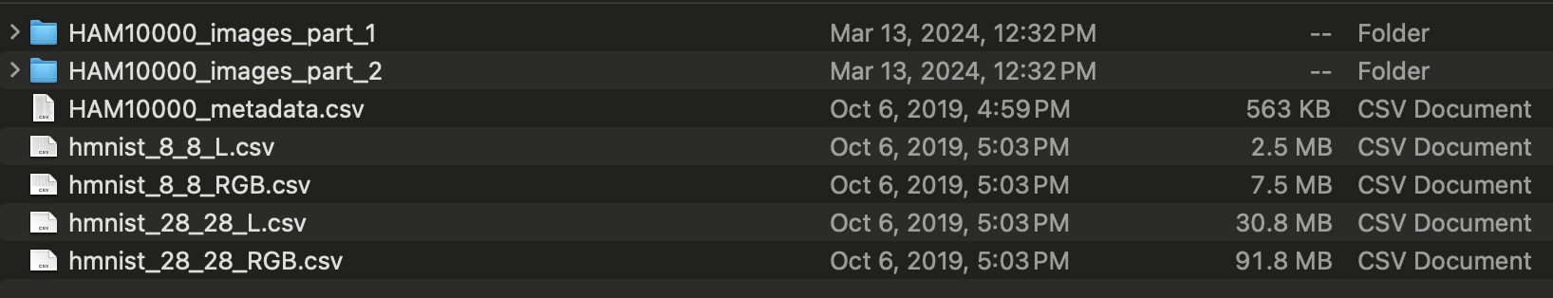
Data Preprocessing
Downloaded the dataset from https://dataverse.harvard.edu/HAM10000

Slide 7
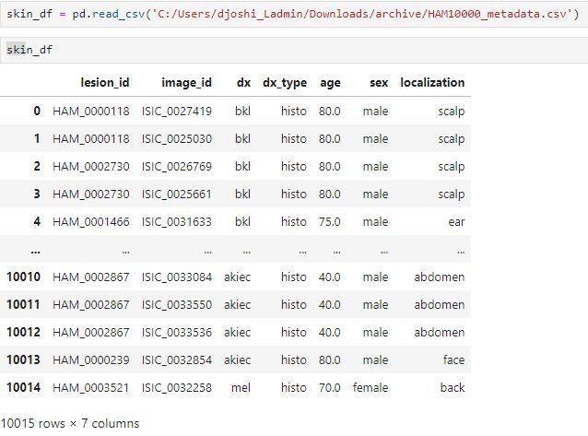

Slide 8
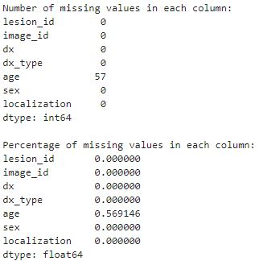
We get the missing values in the age column, so we use the KNNImputer method (K Nearest Neighbor)

Slide 9
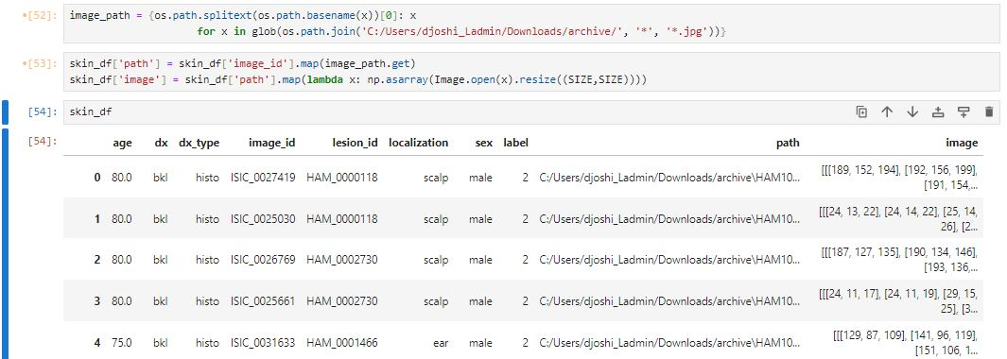
Resizing the images

Slide 10
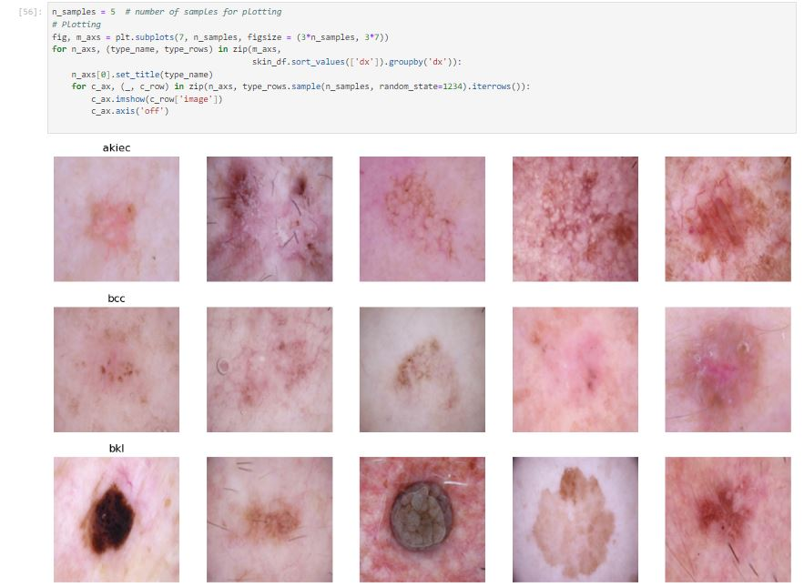
Showing images from
particular lesion types
As per the dataframe.

Slide 11
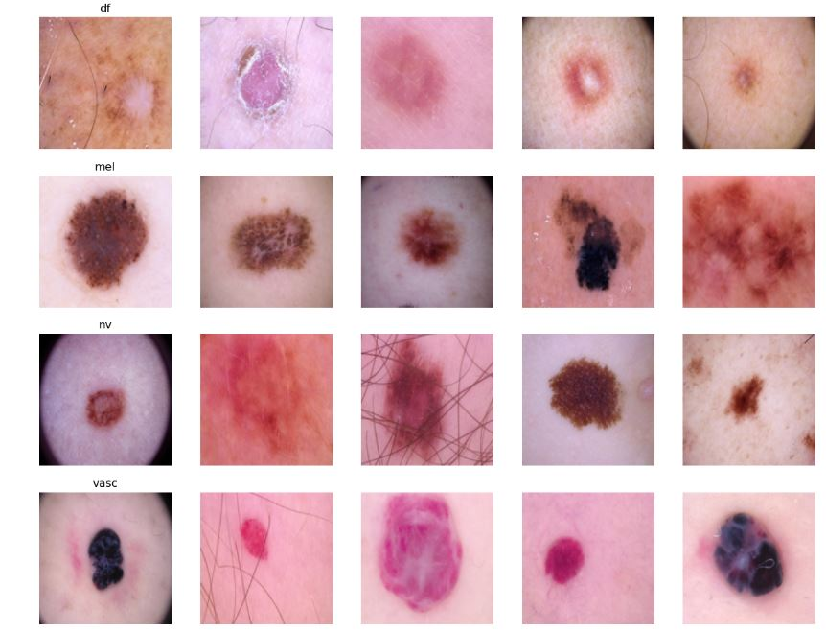

Slide 12
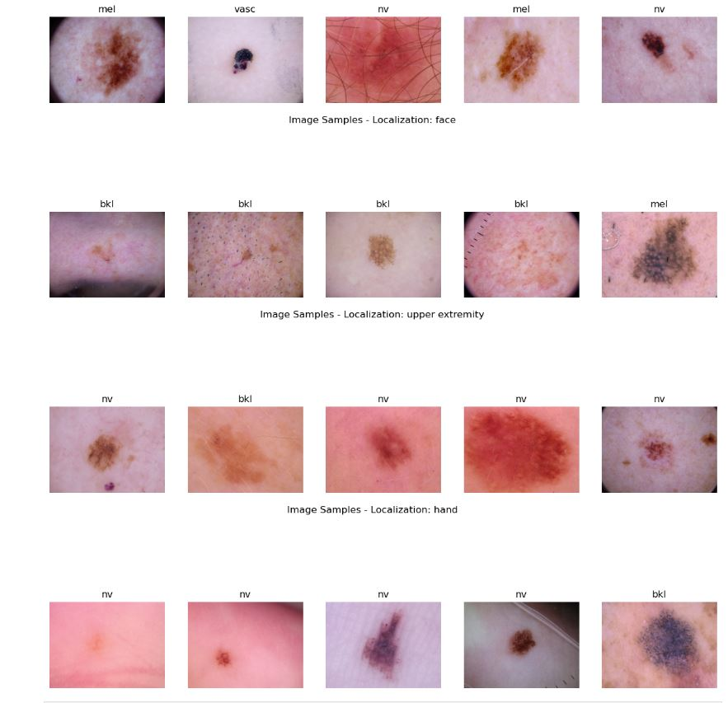
Image samples by there
Localizations for e.g.
Back, Face, Upper extremity,
Hand.

Slide 13
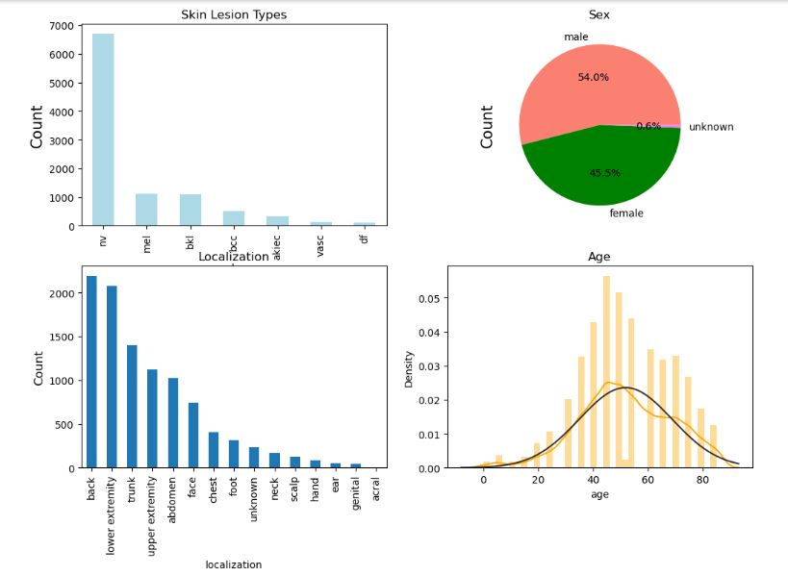
Visualization

Slide 14
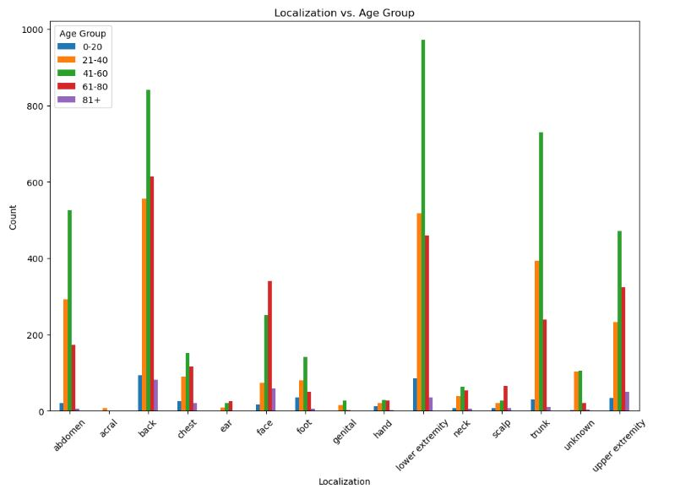

Slide 15
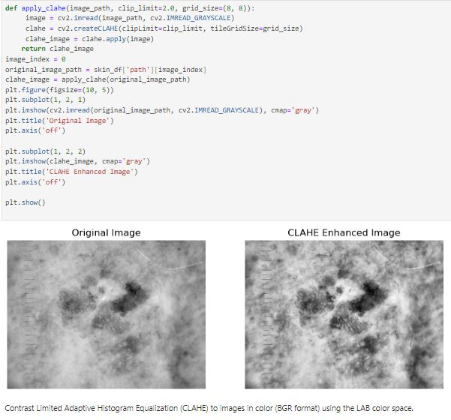
Image Color Normalization

Slide 16
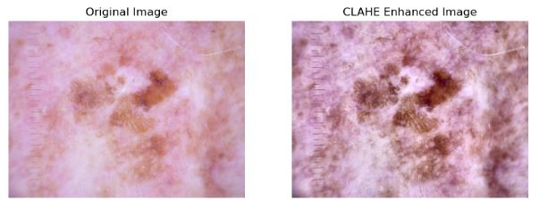
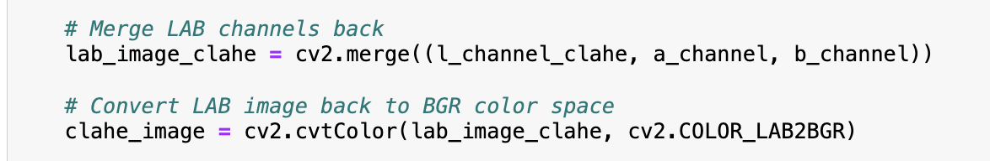

Slide 17
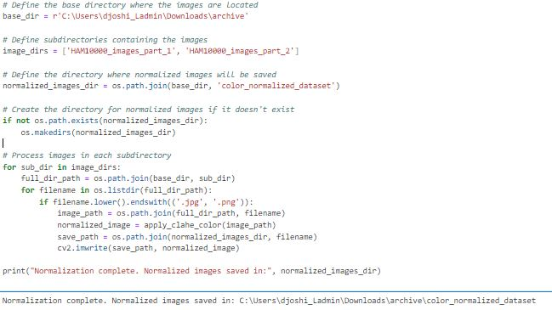

Output :

Slide 18

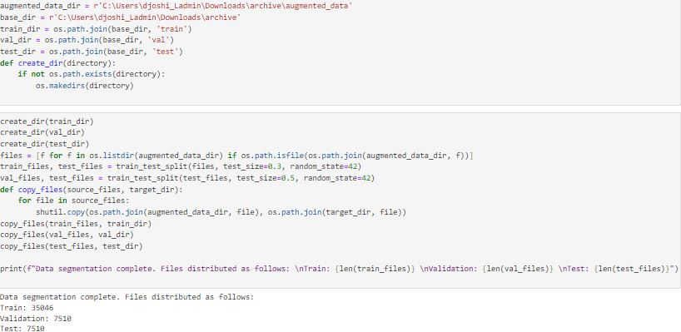
Data Augmentation

Slide 19

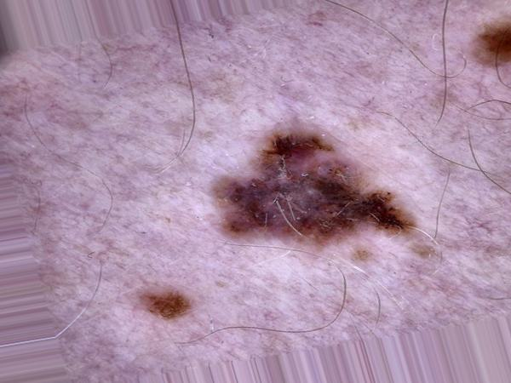
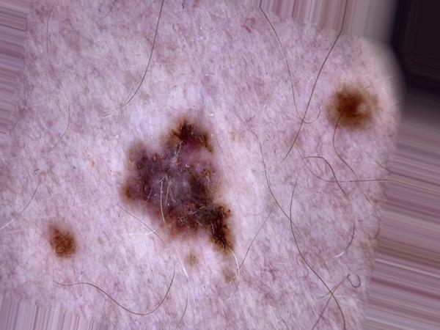
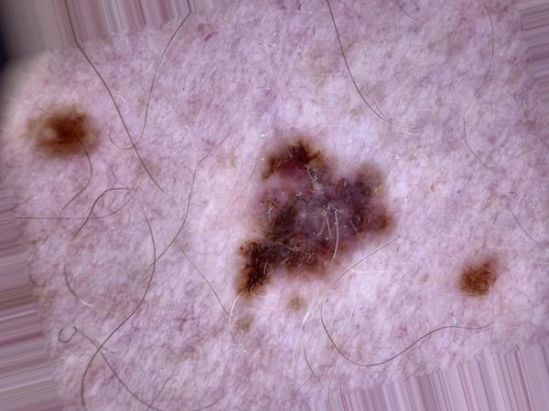
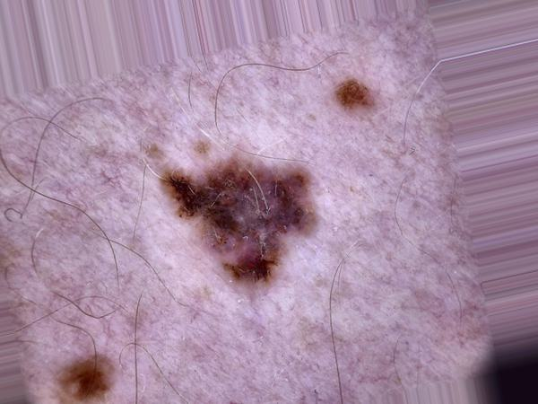
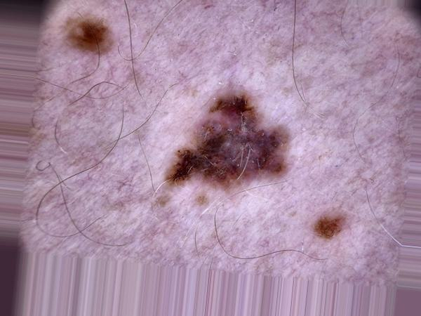
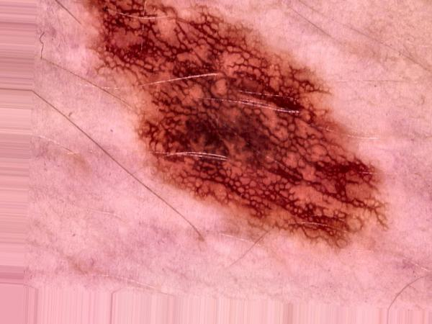
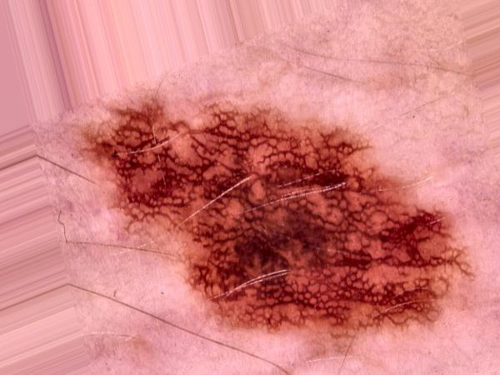
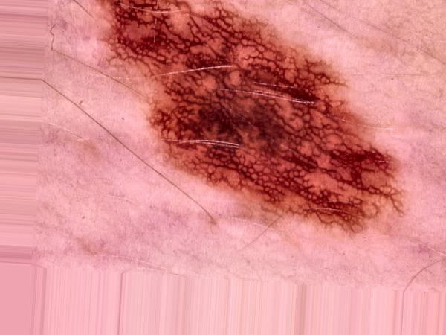
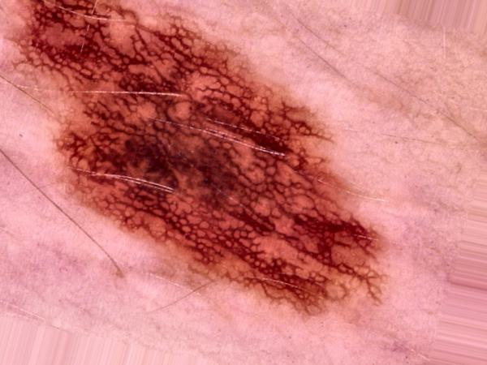
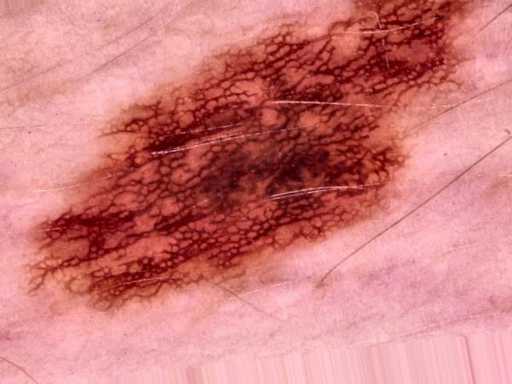
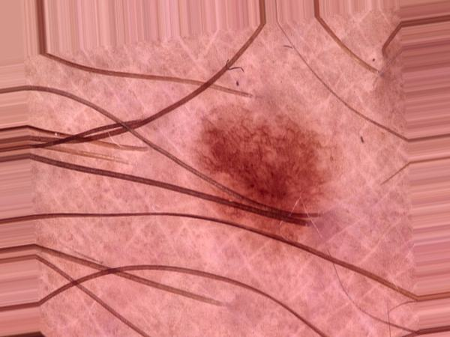
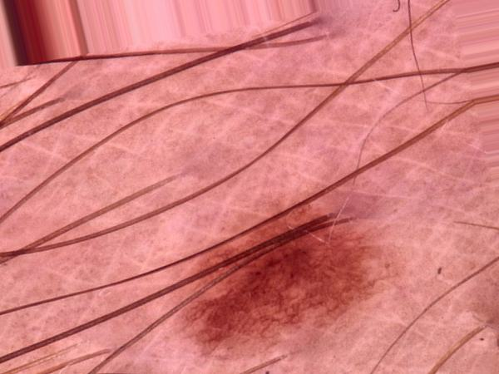
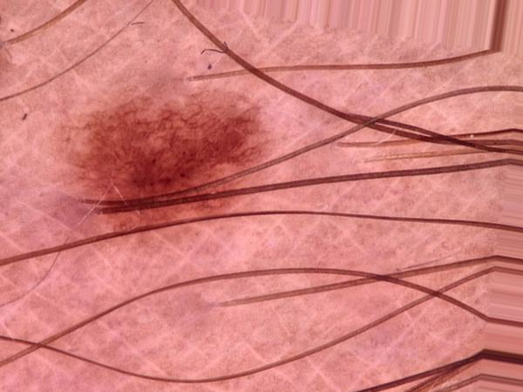
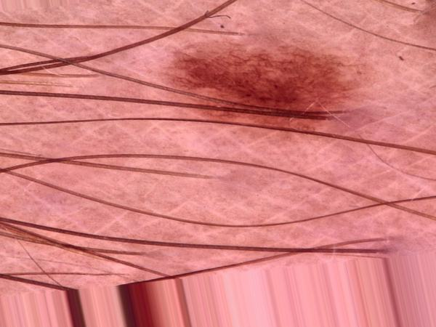
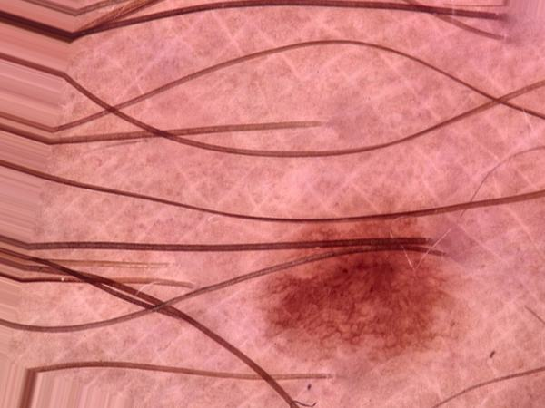

Slide 20
Data Segmentation

Slide 21
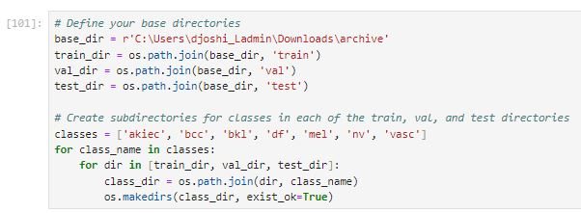
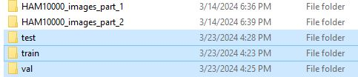
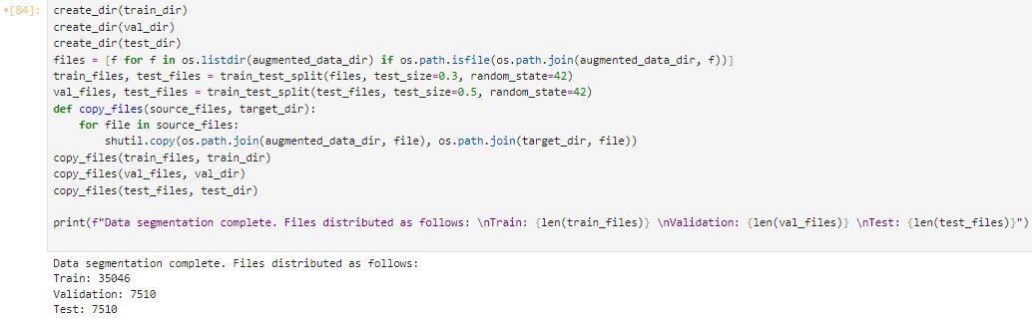
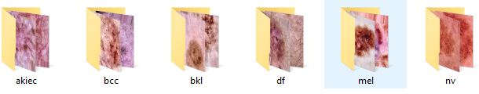

Slide 22
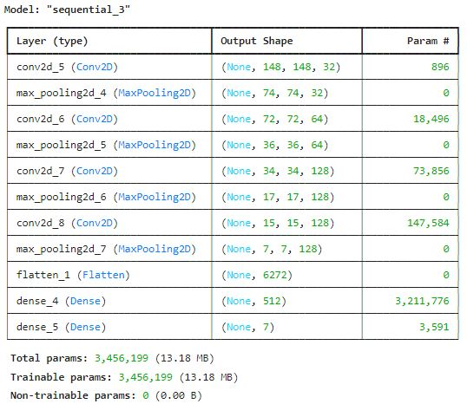
Convolutional Neutral Network

Slide 23
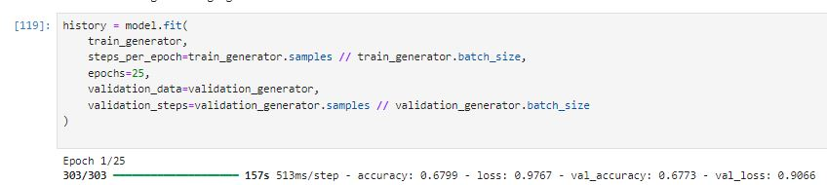
Running Epoch of 25. We get the accuracy of 0.73.

Slide 24
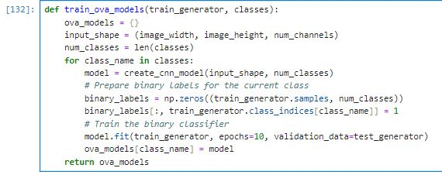
CNN with One Versus All Model
Notes:
The One Versus All (OVA) strategy, also known as One Versus Rest (OVR) or One-vs-the-Rest (OVR), is a common technique for solving multi-class classification problems using binary classifiers. the OVA approach can be particularly useful when dealing with a large number of classes or when the classes are not mutually exclusive (e.g., an image could belong to multiple classes simultaneously). By training a separate binary classifier for each class, the model can learn to distinguish that class from the rest more effectively. The training is performed for a specified number of epochs (that is10). it means that each class with run 10 epoch, whereas the classes are the lesions catergories bcc,nv n all.

Slide 25
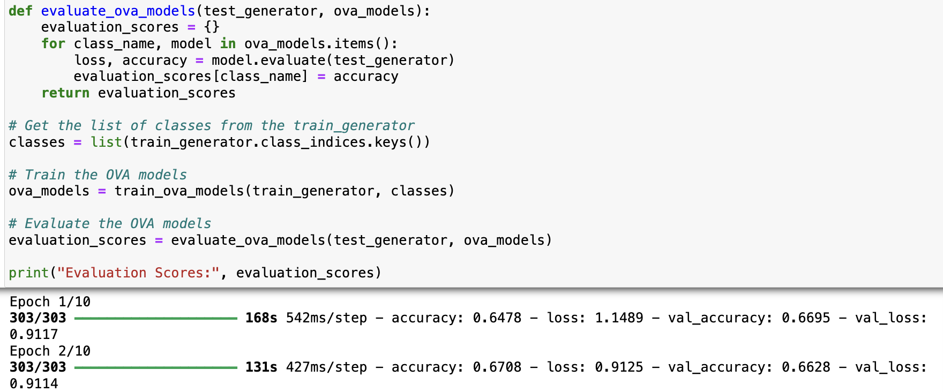
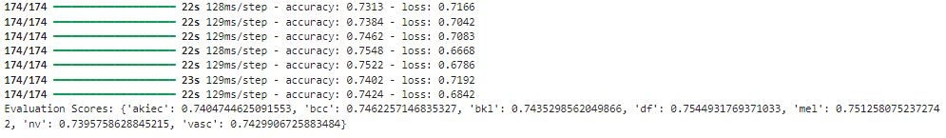
Notes:
The scores give us an understanding of how well the model performs in classifying each specific class of skin lesion. For example, the model seems to perform best on the 'df' class (dermafibroma) with an accuracy of 0.7544931769371033, and slightly worse on the 'nv' class (melanocytic nevi) with an accuracy of 0.7395758628845215.
Classes with lower evaluation scores may indicate that they are more challenging for the model to classify accurately. In this case, classes like 'akiec' (actinic keratosis) and 'nv' (melanocytic nevi) have relatively lower scores compared to others,

Slide 26
Results
While interpreting the CNN model, we got an accuracy of 0.73 or 73% which was not sufficient for a image classification as compared to different classification model during research.
CNN with OVA approach performs better, showing the highest and lowest class accuracies.
Dataset has an imbalanced class distribution, with some classes having significantly fewer samples than others, the evaluation scores can help identify the classes that may be underrepresented or difficult to learn due to the imbalance.
Notes:
For a better prediction, we can combine the multiple binary classifiers to make the final multi-class prediction.

Slide 27
Future Scope
Leverage pre-trained models (e.g., ImageNet) to improve lesion classification.
Focus on relevant image regions for better interpretability and precision.
Balancing and preprocessing the imbalanced data will give a better approach for detection of malignant and benign lesions.
Implement more complex models like VGGNet, ResNet, or DenseNet, which can capture deeper and more abstract features from images.
Notes:
Utilize pre-trained models on larger datasets (e.g., ImageNet) and fine-tune them on the HAM10000 dataset.
Transfer learning can help leverage the learned features from general image recognition tasks and adapt them to the specific domain of skin lesion classification.
IT Means that the images which includes lesions with hair, where the area which include hair will be remove during preprocesing the data for better model performance.

Slide 28
References
https://iecscience.org/public/jpapers/47 (Detection of Skin Diseases from Dermoscopy Image Using the combination of Convolutional Neural Network and One-versus-All)
https://www.sciencedirect.com/science/article/abs/pii/S0957417420307132(Data augmentation for skin lesion using self-attention based progressive generative adversarial network)
https://www.sciencedirect.com/science/article/pii/S2667099222000457(Hybrid convolutional neural networks with SVM classifier for classification of skin cancer)
https://ieeexplore.ieee.org/document/10047280(Skin Cancer Classification using CNN in Comparison with Support Vector Machine for Better Accuracy)

Slide 29
https://ieeexplore.ieee.org/document/8257738 (The melanoma skin cancer detection and classification using support vector machine)
https://ieeexplore.ieee.org/document/10346792(Skin Cancer Detection Using CNN)
https://www.ncbi.nlm.nih.gov/pmc/articles/PMC6616181(The potential for artificial intelligence in healthcare)
https://arxiv.org/abs/ 17105006 (Codella, N. C. F. et al. Skin Lesion Analysis Toward Melanoma Detection: A Challenge at the 2017 International Symposium)
https://arxiv.org/abs/1905.11946 (EfficientNet: Rethinking Model Scaling for Convolutional Neural Networks by Mingxing Tan, Quoc V. Le)
https://arxiv.org/abs/1812.01187 (Bag of Tricks for Image Classification with Convolutional Neural Networks by Tong He, Zhi Zhang, Hang Zhang, Zhongyue Zhang, Junyuan Xie, Mu Li)

Slide 30
Thank you.

